Slide 1
Digital Decentralization:
Ethical Democracy via Blockchain and AI
Academic Statement: All subjects in this section are presented from a liberal democratic perspective.
“Digital Decentralization: Ethical Democracy via Blockchain and Artificial Intelligence”
This work is licensed under the CC BY-NC-ND 4.0 public license.
Dario Rodrigues - 2024

Slide 2
Playlist - 20 Video Series Episodes - Playlist Book – “Decentralization: Ethical Democracy via Blockchain and AI” – Book
1. Pilot Episode
2. Introduction
3. Money: An Accounting System
4. Back to the Future of Money
5. Cryptography and AI Impact
6. Programmable Digital Currencies
7. Cryptoeconomics
8. CBDC: Centralization of Digital Money
9. Blockchain & AI Impact: Healthcare
10. Education
11. Philanthropy
12. Arts and Entertainment
13. Energy
14. Finance
15. Real Estate
16. Logistics
17. Governance
18. Security and Defense
19. Digital Identity
20. Conclusions
©© - This work is licensed under:
CC BY-NC-ND 4.0 public license

Slide 3
1. Pilot Episode
Blockchain and AI are poised to reshape financial and political systems, emphasizing the importance of ethical considerations in this transformative process.
The Transformative Potential of Programmable Money: Cryptography and AI are redefining trust and knowledge, introducing programmability to money. This silent revolution in financial engineering may foster ethics, privacy, and transparency, guiding political reform toward a more equitable society.
Decentralization vs. Centralization: Current political and economic landscapes present a decisive crossroads: data centralization under state and corporate control versus digital decentralization promoting transparency and integrity. Choosing the latter may prevent a dystopian future and help support democratic values.
Ethical and Political Implications of Digital Currencies: Understanding the origin of money is crucial to grasping the ethical and political consequences of new digital currencies. Embracing innovative monetary architectures aligned with human values can safeguard democracy and ensure privacy and freedom in the digital age.
Photo by Hitesh Choudhary on Unsplash
Licensed under: CC BY-NC-ND 4.0
Please refer to the glossary of this slide on page 44 of the book 'Digital Decentralization: Ethical Democracy via Blockchain and AI’

Slide 4
2. Introduction
AI and blockchain technologies' transformative potential and new ethical challenges emphasize the need for reform and robust data ownership in the digital age.
Emergent Technologies and Data Ownership: AI and blockchain empower data ownership, enhancing individual autonomy and accountability. Advanced cryptography reconciles transparency, privacy, and convenience, fostering a safe, fair, and peaceful society.
Ethical Challenges of AI and Blockchain: Misuse of AI and blockchain can amplify misinformation, undermining democracy and social stability. Political actors must anticipate and mitigate the risks associated with these distributed technologies to prevent ethical pitfalls and societal harm.
Programmable Digital Currencies and Political Reform: If transparent and ethical, digital currencies may help eradicate corruption. Understanding the presente evolution of money highlights the potential for digital currencies to restore ethical principles and human values.
Photo by Arthur Mazi on Unsplash
Licensed under: CC BY-NC-ND 4.0
Please refer to the glossary of this slide on page 44 of the book 'Digital Decentralization: Ethical Democracy via Blockchain and AI’

Slide 5
3. Incentives Beginning: A Ledger System
The pre-historical ethical dimensions of money as a credit system emphasize the potential of digital currencies to re-humanize transactions through decentralized and programmable transactions.
The Pre-Historical Role of Money as a Credit System: Money originated as a mental or virtual system of credits and settlements, predating physical currency. Early human communities managed obligations and rights through trust-based memory systems without immediate exchanges.
Ethical Foundations of Pre-Monetary Systems: Early credit and compensation systems relied on social trust and collective memory in close-knit communities to ensure fairness and ethical behavior. Collective awareness and social cohesion acted as ethical guarantors, deterring unethical actions.
Re-Humanizing Money with Digital Currencies: Programmable digital currencies and smart contracts can restore the ethical principles of primordial money in our “global village.” Digital decentralization offers a path to re-align currency with accounting systems that include human values.
Photo by Giammarco Boscaro on Unsplash
Licensed under: CC BY-NC-ND 4.0
Please refer to the glossary of this slide on page 44 of the book 'Digital Decentralization: Ethical Democracy via Blockchain and AI’

Slide 6
4. Back to the Future of Money
The conceptual pre-historical nature of money emphasizes the potential of digital currencies to reintroduce ethical considerations into financial transactions and promote a decentralized, transparent financial system.
Historical and Conceptual Nature of Money: Money has functioned more as a record of promises and credits than as a physical object for exchange. Examples like the Yap Islands' stone discs illustrate money's role as a mental and collective record of transactions.
Digital Currencies and Ethical Considerations: Digital currencies, like primordial money, are more than means of payment. They serve multiple functions in global cryptographic ledgers. Integrating human values into digital currencies opens up innovative multidimensional possibilities for more fair and transparent financial operations, hopefully providing a more ethical future for transactions.
Digital Decentralization and the Future of Money: Decentralized digital currency (cryptocurrency) and centralized ones (CBDC) transform the financial landscape by reintegrating exchange and use values, much like in pre-monetary societies, using the two production factors, capital and labor, in money. Digital decentralization promotes transparency, equity, and civic participation, ensuring more democratic control over financial transactions and political decisions.
Photo by Dario Bronnimann on Unsplash
Credit to Elisabeth Krämer-Bannow, Public Domain, via Wikimedia Commons
Licensed under: CC BY-NC-ND 4.0
Please refer to the glossary of this slide on page 45 of the book 'Digital Decentralization: Ethical Democracy via Blockchain and AI’

Slide 7
5. Cryptography and Artificial Intelligence Impact
Cryptography and AI have profound ethical implications for social media and monetary systems. These technologies' role in addressing disinformation and unemployment can promote a more fair society.
Cryptography and AI for Secure and Transparent Systems: Cryptography provides tamper-proof, decentralized records, guaranteeing secure transactions without intermediaries. In turn, AI optimizes decisions and processes by analyzing large volumes of data. Together, these technologies can make the environment less prone to corruption and distrust.
Ethical and Transparent Monetary Systems: The use of advanced cryptography and AI enables the integration of both production factors, labor and capital, into digital currencies with specific utilities (e.g., utility tokens), potentially promoting a more ethical and transparent monetary system. Innovations like zero-knowledge proofs (ZDK) can ensure online authenticity without compromising privacy.
Addressing Inequality and Disinformation: Redistributive iniciatives like universal basic income (UBI), supported by cryptography and AI, offer economic stability amidst potential job losses due to intelligent automation, promoting social equity and reducing poverty. Cryptographic advancements combat disinformation by verifying content sources, maintaining social stability, and fostering an informed digital public sphere.
Image obtained using AI
Licensed under: CC BY-NC-ND 4.0
Please refer to the glossary of this slide on page 45 of the book 'Digital Decentralization: Ethical Democracy via Blockchain and AI’

Slide 8
6. Programmable Digital Currencies
Programmable digital currencies have high transformative potential. Their security and transparency requisites and ethical implications advocate for decentralized models to promote democracy and inclusion.
Programmability and Decentralization of Digital Currencies: Digital currencies can be programmed and managed by entities like central banks or decentralized by their user communities. Decentralized models enhance individual autonomy and economic innovation through the distributed trust provided by blockchain technology.
Security and Transparency through Cryptography: Cryptographic mechanisms ensure the security and transparency of decentralized digital currencies, reducing the need for a central authority. This decentralized model promotes censorship resistance and trust, enabling ethical and societal reforms and more effective control of corruption.
Ethical Implications and Smart Contracts: One of the most exciting aspects of digital currencies is their ability to use smart contracts. These contracts enable programmable and traceable transactions, ensuring automatic and unquestionable fulfillment of agreements. This ethical use of digital currencies can revolutionize access to financial capital, foster social inclusion, and bolster transparency, for instance, making forgeries a thing of the past.
Photo by Traxer on Unsplash
Licensed under: CC BY-NC-ND 4.0
Please refer to the glossary of this slide on page 45 of the book 'Digital Decentralization: Ethical Democracy via Blockchain and AI’

Slide 9
7. Cryptoeconomics
“Cryptoeconomics” emphasizes the importance of decentralized systems in aligning free initiative with inclusive and sustainable behaviors.
Transparent and Secure Decentralized Economic Systems: Cryptoeconomics harnesses the power of blockchain technology and AI to create transparent, secure, and decentralized digital transactions. Distributed cryptographic ledgers are open for everyone to review but nearly impossible to forge, instilling confidence in the integrity of economic systems.
Ethical Financial Transactions and Smart Contracts: Smart contracts and decentralized applications (dApps) enable transactions that integrate ethical criteria, redefining financial value. Digital money can encourage actions favoring sustainability and social cooperation, aligning individual profit with collective benefit.
Decentralized Autonomous Organizations (DAOs): DAOs operate without central authority, ensuring transparent collective decisions through blockchain technology. Tokens and cryptocurrencies in DAOs serve as votes and reward positive actions while deterring negative ones, eventually promoting sustainable and ethical behaviors.
Credit to DeltaWorks, Public Domain, via Pixabay.
Licensed under: CC BY-NC-ND 4.0
Please refer to the glossary of this slide on page 46 of the book ”Digital Decentralization: Ethical Democracy via Blockchain and AI’

Slide 10
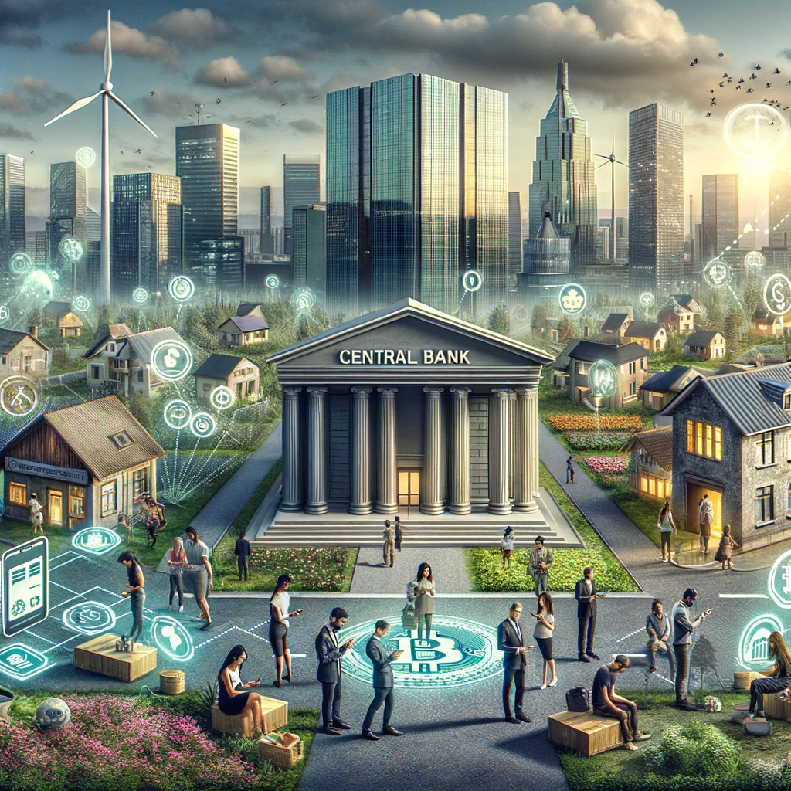
8. CBDC: Centralization of Digital Money
The ethical dilemmas and privacy concerns associated with Central Bank Digital Currency (CBDC) and the balance between inclusion and privacy require protecting individual rights while leveraging CBDC's benefits.
Centralization vs. Decentralization of Digital Currencies: Central Bank Digital Currency (CBDC) enhances economic and financial policy efficiency but risks reducing individual autonomy through increased state control of financial transactions. Unlike cryptocurrencies that foster financial independence, CBDC represents a centralized monetary system that may compromise privacy and increase dependency on central banks.
Ethical Dilemmas and Privacy Concerns: The centralization inherent in CBDC poses significant security challenges, creating a "single point of failure" and making the financial system more vulnerable to cyberattacks. The potential for surveillance and abusive citizen control threatens individual freedom, raising ethical concerns both in authoritarian and democratic regimes.
Balancing Financial Inclusion and Privacy: CBDCs offer significant benefits for financial inclusion, providing immediate and cost-free transactions, especially in underserved areas. Implementing measures such as pseudonymity and regulated access to transaction data can balance privacy with security, ensuring that CBDCs support financial inclusion without compromising individual autonomy and citizens' rights.
Image obtained using AI
Licensed under: CC BY-NC-ND 4.0
Please refer to the glossary of this slide on page 46 of the book 'Digital Decentralization: Ethical Democracy via Blockchain and AI’

Slide 11
9. Cryptography & AI in Healthcare
Blockchain and AI enhance patient privacy, improve data management, combat counterfeiting, and personalize treatments. Digital decentralization addresses these technologies' ethical impact in healthcare.
Enhanced Patient Privacy and Data Management: Blockchain and AI improve clinical data management and medical records, enhancing patient privacy and enabling secure data sharing. Patients gain control over their data, facilitating participation in research and redistributing wealth in the healthcare industry through financial rewards for data sharing.
Combating Counterfeiting and Personalizing Treatments: Blockchain verifies the authenticity of medications, combating counterfeiting. AI analyzes vast amounts of health data, contributing to scientific research and the personalization of medical treatments.
Ethical and Political Implications: Integrating AI and blockchain in Healthcare brings the need for transparent and ethical data-sharing practices to the forefront. This is crucial to respect patient consent and privacy. Digital decentralization, as a strategy for transparent health data governance, promotes equity in access and quality of Healthcare and serves as a safeguard for patient rights.
Photo by Creativeart on Freepik
Licensed under: CC BY-NC-ND 4.0
Please refer to the glossary of this slide on page 47 of the book 'Digital Decentralization: Ethical Democracy via Blockchain and AI’

Slide 12
10. Blockchain and AI in Education
Blockchain and AI can transform education by ensuring secure credential verification, enhancing personalized learning, and promoting ethical and transparent educational practices.
Verification and Management of Academic Credentials: Blockchain offers secure and immutable digital records for verifying and managing academic credentials, ensuring integrity and transparency. This technology helps promoting global portability and recognition of educational qualifications, creating an economical and decentralized way to issue, store, and verify credentials.
Personalized Learning and Pedagogical Enhancement: AI analyzes student learning patterns to provide personalized educational content, improving teaching outcomes. AI's ability to identify struggling areas allows for more effective educational interventions, enhancing the overall learning experience.
Ethical and Political Implications: Digital decentralization democratizes access to knowledge, promoting a more pluralistic and capable society. Blockchain ensures data validation and the integrity of academic records, supporting a more decentralized, transparente, and collaborative learning environment. Embracing these technologies requires innovative policies to provide unbiased, autonomous, and personalized education while fostering a critical approach to evaluating content.
Photo by Marvin Meyer on Unsplash
Licensed under: CC BY-NC-ND 4.0
Please refer to the glossary of this slide on page 47 of the book 'Digital Decentralization: Ethical Democracy via Blockchain and AI’

Slide 13
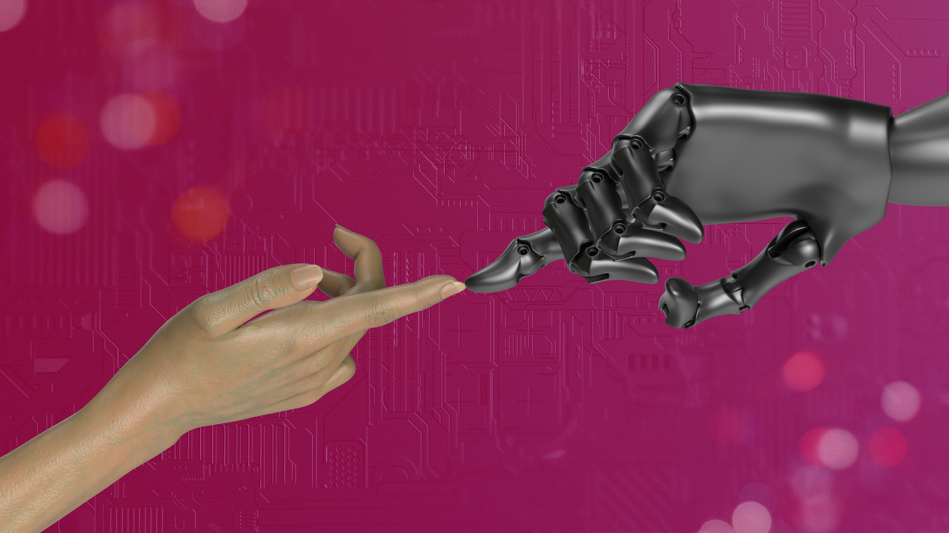
11. Blockchain and AI in Philanthropy
Blockchain and AI enhance transparency and trust in philanthropy, optimize resource allocation and ethical financial incentives, promoting greater community involvement and more effective charitable efforts.
Enhanced Transparency and Trust: Blockchain technology enhances transparency in philanthropic activities by allowing donors to monitor their funds' journey, increasing trust and accountability in the sector. This transparency ensures that resources are used efficiently and for their intended purposes, reducing operational costs and boosting the effectiveness of donations.
Optimized Resource Allocation with AI: AI analyzes large volumes of data to identify urgent needs, optimizing resource allocation in the philanthropic sector. This data-driven approach improves the efficiency and relevance of social economy organizations, leading to a more significant impact from charitable projects.
DAOs and Ethical Money: Decentralized Autonomous Organizations (DAOs) revolutionize philanthropy by providing transparent collective decisions on blockchain networks, using digital voting tokens, and stimulating community involvement. This combination of financial incentives and philanthropic activities fosters more significant individual commitment to collective action, aligning altruism with community needs.
Photo by Igor Omilaev on Unsplash
Licensed under: CC BY-NC-ND 4.0
Please refer to the glossary of this slide on page 48 of the book 'Digital Decentralization: Ethical Democracy via Blockchain and AI’

Slide 14
12. Blockchain and AI in Arts and Entertainment
Blockchain and AI impact copyright management and applications in arts and entertainment. Their ethical implications advocate for policies that promote transparency, equity, and cultural diversity.
Revolutionizing Copyright and Income Distribution: Blockchain technology facilitates secure and transparent registration of works, ensuring fairer compensation for authors. Self-executing smart contracts reduce intermediary costs, leading to more equitable income redistribution in the arts and entertainment industry.
Innovative Applications of AI and Blockchain: AI generates unique digital art from textual descriptions and enhances augmented reality experiences, offering personalized and immersive interactions. Blockchain and non-fungible tokens (NFTs) enable actual ownership of digital assets in video games, providing secure, and transparent transactions and creating new paradigms in online gaming.
Ethical and Political Implications: Blockchain and AI democratize access to platforms and computing resources, challenging the dominance of large corporations. Promoting greater transparency in copyright management and income distribution can influence public policies, protect artists' rights, and encourage innovation and cultural diversity.
Credits to Geralt, Public Domain, via Pixabay
Licensed under: CC BY-NC-ND 4.0
Please refer to the glossary of this slide on page 49 of the book 'Digital Decentralization: Ethical Democracy via Blockchain and AI’

Slide 15
13. Blockchain and AI in Energy
Blockchain and AI impact energy distribution and trading and may contribute to optimizing energy systems Hence, one must consider the ethical and political implications of digital decentralization in the energy sector.
Decentralized Energy Distribution and Trading: Blockchain enables decentralized digital networks, allowing direct transactions between renewable energy consumers and producers. This disintermediation makes energy more accessible and promotes the decentralized production of renewable forms, enhancing sustainability.
Optimization of Energy Systems: AI predicts consumption patterns and optimizes energy distribution, facilitating mutually beneficial energy transactions. Cryptocurrencies can function as "virtual batteries," promoting economically efficient energy recycling, contributing to electric grids' stability.
Ethical and Political Implications: Adopting blockchain and AI in the energy sector democratizes energy access and redistributes economic power, promoting sustainable energy policies. Fostering innovation and digital decentralization is essential to involving small and medium producers and ensuring a balanced and efficient energy market.
Image obtained using AI
Licensed under: CC BY-NC-ND 4.0
Please refer to the glossary of this slide on page 49 of the book 'Digital Decentralization: Ethical Democracy via Blockchain and AI’

Slide 16
14. Blockchain and AI in Finance
Blockchain and AI in finance bring automated and transparent transactions. This technological evolution has broad ethical and political implications.
Disintermediation and Efficiency in Finance: Blockchain and AI significantly reduce transaction costs, leading to more expedient and direct financial transactions without intermediaries. Smart contracts ensure the fulfillment of agreements by conditioning financial transactions with specific rules, enhancing efficiency and reliability.
Decentralized Transactions and Transparency: Decentralized financial systems may promote transparency and incorporate factors relevant to sustainability and social well-being, aligning transactions with ethical principles. Through transparent records and AI-optimized processes, these systems can offer financial options that reflect human values, such as socially responsible investing and green finance initiatives. By enabling collective action through individual recognizable merit, they can effectively address social and environmental challenges, fostering a more equitable and sustainable future.
Ethical and Political Implications: Integrating blockchain and AI in finance allows a more just distribution of resources and a more participative democracy. These technologies enable transactions to integrate ethical, social, and ecological values, potentially eradicating corruption by aligning money with ethical standards.
Image obtained using AI
Licensed under: CC BY-NC-ND 4.0
Please refer to the glossary of this slide on page 50 of the book 'Digital Decentralization: Ethical Democracy via Blockchain and AI’

Slide 17
15. Blockchain and AI in Real Estate
Blockchain and AI on real estate emphasizes the importance of tokenization, and the ethical and political implications of promoting global economic interdependence and inclusion through digital decentralization.
Tokenization and Smart Contracts: Real estate tokenization is about issuing digital tokens representing fragmented property value, enabling efficient and flexible transactions through smart contracts. Tokens grant specific rights, such as receiving rental income or participating in property appreciation, and outline obligations, such as financial contributions to real estate development.
Transparency and Security: Distributed ledger technologies (DLT) maintain transparent and immutable records of digital property titles, reducing fraud and simplifying transactions. This increased security and liquidity in real estate facilitates transactions and enhances market liquidity.
Ethical and Political Implications: Tokenization may foster a sense of ownership, social affiliation, and responsibility, contributing to social stability and mitigating inequalities. Promoting fractional ownership across borders can encourage economic interdependence and global understanding. Nevertheless, it raises ethical and regulatory challenges that require careful management.
Credit to DigiPD, Public Domain, via Pixabay;
Licensed under: CC BY-NC-ND 4.0
Please refer to the glossary of this slide on page 51 of the book 'Digital Decentralization: Ethical Democracy via Blockchain and AI’

Slide 18
16. Blockchain and AI in Logistics
Blockchain and AI in logistics enhance transparency and security, optimizing supply chains. The ethical and political implications of reducing transaction costs through digital decentralization are paramount.
Enhanced Transparency and Security: Blockchain technology provides unparalleled transparency and security in supply chain management by verifying product authenticity and ensuring ethical and environmental compliance. 'Oracles' play a crucial role by transmitting physical world data (off-chain) to blockchain ecosystems, enhancing supply chain reliability from the source to the final consumer.
Optimization and Cost Reduction: Blockchain and AI increase supply chain efficiency, and improve service quality by predicting demand. These technologies enable the automation of agreements and optimize payments, reducing errors and delays along the businesses chain.
Ethical and Political Implications: Integrating blockchain and AI in logistics reduce costs and may promote an ethical redistribution of value by harmonizing commercial and social interests. Digital decentralization empowers small and medium-sized producers and suppliers, counterbalancing the dominance of large multinationals and leading to a fairer and more sustainable economic system.
Photo by CHUTTERSNAP on Unsplash
Licensed under: CC BY-NC-ND 4.0
Please refer to the glossary of this slide on page 51 of the book 'Digital Decentralization: Ethical Democracy via Blockchain and AI’

Slide 19
17. Cryptography and AI in Governance
Cryptography and AI may enhance electoral processes' security, transparency, and agility, promoting participatory democracy.
Enhanced Security and Transparency in Electoral Processes: Cryptography ensures high-security standards for electronic voting, enhancing the integrity and transparency of electoral processes. Blockchain technology can guarantee the security of votes and the transparency of scrutiny processes, reducing the potential for fraud and increasing trust in the electoral system.
AI's Role in Political Analysis and Decision Making: AI utilizes predictive modeling and sentiment analysis to anticipate electoral results and customize campaigns, shaping electoral strategies and voter influence. AI analyzes patterns and preferences post-election to help governments understand voter expectations and smart contracts may help implement campaign promises effectively.
Participatory Democracy and Digital Decentralization: Integrating cryptography and AI can foster more participatory democracy, reducing the need for traditional representatives by enabling active citizen involvement through digital tokens and self-executing contracts. This digital decentralization promotes transparency, accountability, and efficiency in governance, encouraging ethical practices and restoring institutional trust.
Image obtained using AI
Licensed under: CC BY-NC-ND 4.0
Please refer to the glossary of this slide on page 52 of the book 'Digital Decentralization: Ethical Democracy via Blockchain and AI’

Slide 20
18. Cryptography and AI in Security and Defense
Cryptography and AI rely on enhancing decentralized security models, improving threat detection and response, addressing ethical, political and military issues by increasing trust between nations.
Decentralized Security Models: The combination of cryptography and AI supports decentralized digital models, mitigating risks associated with single points of failure. Decentralization complicates attackers' tasks, as they must breach multiple instances to access critical information or cause harm.
Enhanced Threat Detection and Response: AI continuously monitors anomalous behaviors and emerging attack vectors, strengthening threat detection and incident response capabilities. Blockchain technology enhances security and transparency in military supply chains. At the same time, AI optimizes data analysis and resource allocation in various defense scenarios.
Ethical and Political Implications: Advanced cryptographic techniques, such as homomorphic encryption and zero-knowledge proofs, enable the verification of critical military actions without disclosing sensitive information. Integrating cryptography and AI in defense can increase trust between nations by ensuring transparent compliance with disarmament treaties and other international agreements while maintaining the confidentiality of top-secret issues.
Credit to John-i, Public Domain, via Pixabay
Licensed under: CC BY-NC-ND 4.0
Please refer to the glossary of this slide on page 53 of the book 'Digital Decentralization: Ethical Democracy via Blockchain and AI’

Slide 21
19. Advanced Cryptography and AI in Digital Identity
Blockchain and AI allow secure digital identity management, combat disinformation, and highlight digital decentralization's ethical and political implications in promoting social equity and democratic values.
Secure and Reliable Digital Identity Management: Blockchain and AI technologies offer secure means for creating, storing, and sharing personal identification information, enhancing financial, economic, and social inclusion. These technologies balance privacy and individual autonomy while providing increased security for the community.
Fighting Disinformation and Ensuring Authenticity: Advanced cryptography and AI can authenticate digital content, such as news, videos, and images, effectively combating disinformation and 'fake news.' Methods like 'Proof-of-Personhood' attest to each human's unique condition, preventing AI from impersonating humans and contributing to a fair resource distribution.
Ethical and Political Implications: Integrating blockchain and AI in sovereign digital identity initiatives promotes security, privacy, and social equity, enhancing civic participation and reinforcing democratic foundations. Initiatives like Universal Basic Income (UBI) benefit from secure digital identity systems, ensuring fair and transparent redistribution of resources and reducing social tensions.
Image obtained using AI
Licensed under: CC BY-NC-ND 4.0
Please refer to the glossary of this slide on page 53 of the book 'Digital Decentralization: Ethical Democracy via Blockchain and AI’

Slide 22
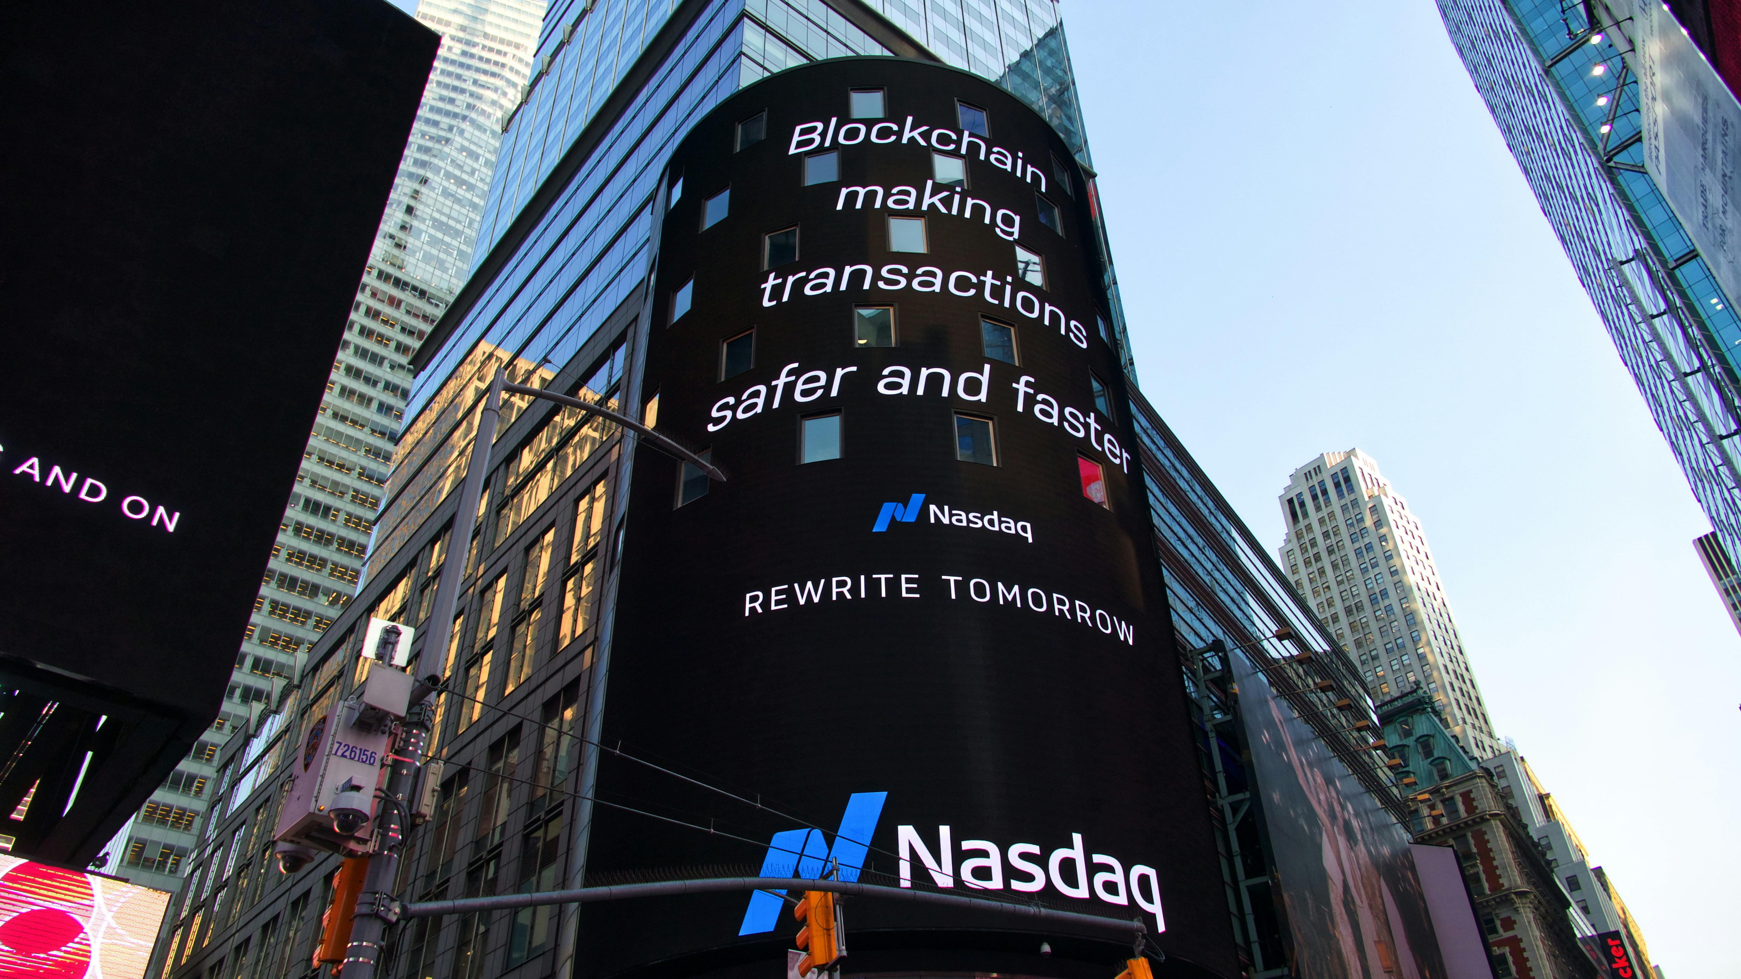
20. Conclusions
Ethically Reinventing Political-Economic and Financial Systems: AI and blockchain technologies create a powerful synergy, with AI enhancing blockchain's transparent security and blockchain boosting AI's sophisticated efficiency. This dynamic combination can drive remarkable advancements, such as effectively combating corruption through digital decentralization and fostering a more equitable and transparent society.
Addressing Data Centralization Risks: Emerging powerful technologies call for urgent reform of political-economic systems to enhance transparency and prevent power abuses. Decentralized monetary systems, such as cryptocurrencies, and smart contracts can mitigate structural single-point-of-failure risks and the control and surveillance risks associated with Central Bank Digital Currency (CBDC), safeguarding privacy and freedom.
Defending Truth and Promoting Inclusion: Innovative projects utilizing advanced cryptography and biometrics can prevent AI from impersonating humans, combat disinformation, and foster inclusion, ensuring information authenticity and preventing sophisticated fraud. Given AI's potential to disrupt job markets, exacerbate disinformation, and augment economic productivity, including causing massive unemployment and aggravating inequality, implementing a secure and redistributive universal basic income (UBI) distribution may be crucial for ensuring social and economic inclusion
Photo by Pascal Bernardon on Unsplash
Licensed under: CC BY-NC-ND 4.0
Please refer to the glossary of this slide on page 54 of the book Digital Decentralization: Ethical Democracy via Blockchain and AI’

